Slide 1
TOPIC:
SILVER SPRINGS HOTEL ROOM
MANAGEMENT SYSTEM
PROGRAMMING PROJECT
Lewis Itegi
MAY COHORT 2024
-

Slide 2
Chapter 1: Introduction
Background
Silver Springs Hotel is a luxury 4 star hotel located in Nairobi, Kenya. It provides accommodation to guests as well as conference rooms for various types of meetings. Rooms are allocated to guests depending on the number of guests, suite paid for, period of stay, and whether any additional services will be required.

Slide 3

Problem Statement
When guests are assigned to a room, their information is recorded in a flat file system and retrieved as required. This poses a serious challenge since flat file systems make it difficult to retrieve and modify records.
Developing a room management system which will allow users to enter, retrieve and modify guest and room records with increased ease within Silver Springs Hotel.

Slide 4
Objectives
Main Objective
To develop a room management system for Silver Springs Hotel.
Specific Objectives
To collect requirements from the stakeholders
To design a room management system that meet user requirements.
To implement the design using appropriate tools.
To test the system to see if it meets user requirements.

Slide 5

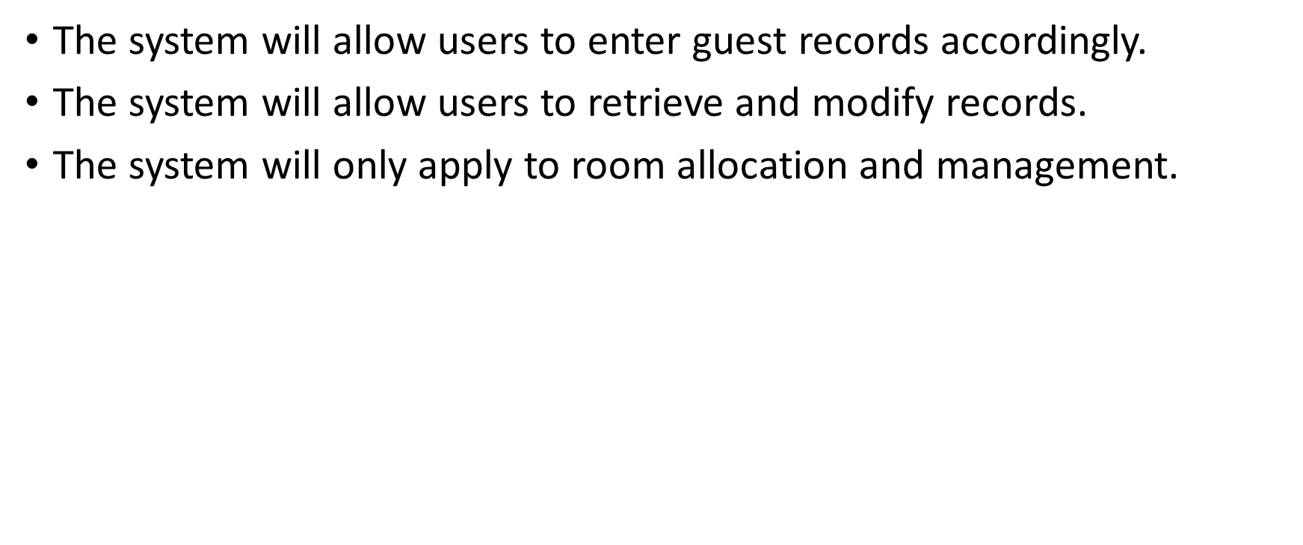
Significance
By increasing the ease of record retrieval and modification, the hotel can increase the efficiency in which they serve their clients, as well as eliminate the data redundancy that presents itself through flat file systems.

Slide 6
Chapter 2: Literature Review
Area In General
A hotel room management system is a system used to record, retrieve and modify guest and room records in a hotel. It does this through users entering the name, room suite, room number and period of stay of the guests. Later on, guests can review and change their room depending on their preferences.

Slide 7
Existing Systems
Hillpark Hotels Room Management System provides a flexible environment for entering records.
The Boma Nairobi Hotel Room Management System is a wide user-friendly system.
Borrowing from the above hotels, Silver Springs Hotel’s room management system will have increased flexibility as well as increased user-friendliness.

Slide 8
Chapter 3: Methodology
Requirements Collection
The user requirements will be collected through interviews and structured questionnaires.
Structured questionnaires allow for information to be gathered from many sources at once while providing all the necessary information needed in a structured manner.
Interviews allow the interviewee to provide as much information as possible while also allowing the interviewer to get first-hand information on the user requirements. It also allows the interviewer to ask any questions not asked in the questionnaires.

Slide 9
Development Methodology
The system will be developed using the waterfall methodology. This is because of the following:
There is a presence of a clear structure.
There is smooth transfer of information.
It is easy to manage.
It will be developed through the analysis, design, development, and testing phases respectively.

Slide 10
Appendices
Resources
SN | Resource | Specification | Usage
1 | Internet Connection | 150 mbps | To provide connection to online resources
2 | Programming Language | HTML, Java 21 | To code with
3 | Computer | SSD, 8GB RAM, 3.5 GHz | To develop and store system
4 | DBMS | MySQL | To create the database
5 | IDE | Visual Studio | To provide environment for programming

Slide 11
Budget
SN | Resource | Quantity | Availability | Estimated Cost(KSh) | Actual Cost(KSh)
1 | Internet | 12 Hours | Own | 5000 | 4000
2 | Flash Drive | 2 | Own | 3200 | 2400
3 | Computer | 1 | Own | 54000 | 47000
4 | Printing Paper | 1 rim | Own | 1300 | 1200
5 | Total |  |  | 63500 | 54600

Slide 12
Project Risks and Mitigations
SN | Risk | Effect | Mitigation
1 | Theft of laptop | Loss of data | Backup copy
2 | Virus attack | System crash and loss of data | Backup copy
3 | Loss of power | Delay in coding | UPS

